Slide 1
PHYS4260 Quantum Mechanics II Spring 2025
Scattering Theory

Slide 2
Outline
Scattering Theory:
Recap: Partial wave analysis formalism
Phase Shifts
The Born Approximation

Slide 3
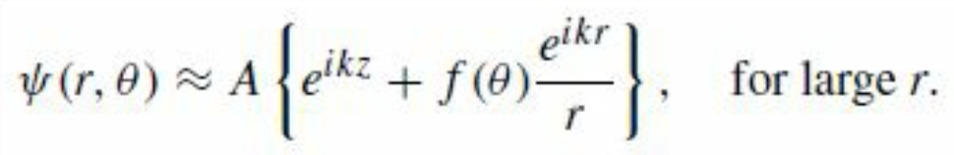
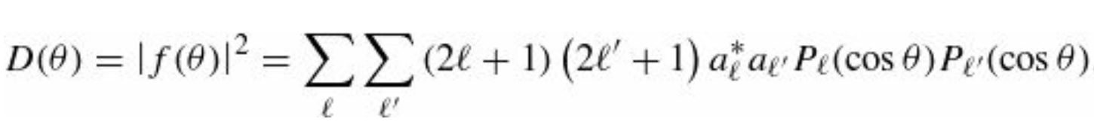
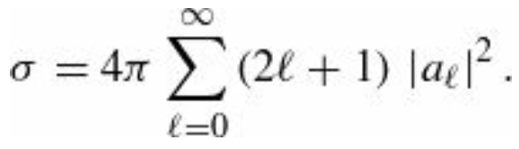
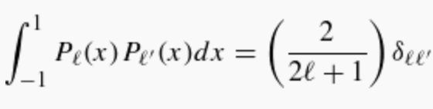
Recap: Partial wave analysis formalism
At the beginning of our discussion of quantum scattering theory we postulated the solution in the large-$r$ region
What we have found, confirms more rigorously this general (postulated) structure and tells us how to compute the
scattering amplitude $f(θ)$ in terms of the partial wave amplitudes $a_{l}$. The differential cross- section is
and the total cross-section is*
*The orthogonality of the Legendre polynomials
has been used to do the angular integration in
the cross-section calculation.

Slide 4
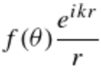
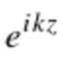
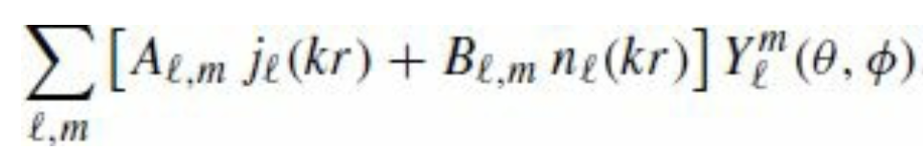
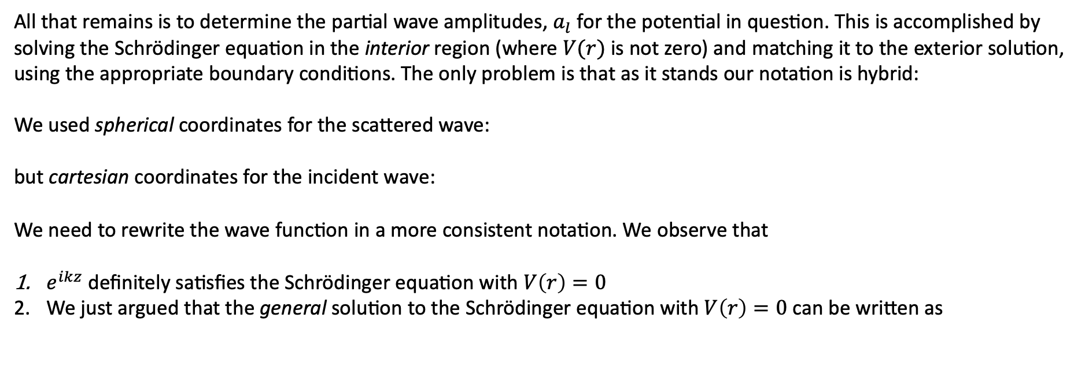
Recap: Partial wave analysis formalism
Determination of the partial wave amplitudes $a_{l}$ for $V(r)$
All that remains is to determine the partial wave amplitudes, $a_{l}$ for the potential in question. This is accomplished by
solving the Schrödinger equation in the interior region (where $V(r)$ is not zero) and matching it to the exterior solution,
using the appropriate boundary conditions. The only problem is that as it stands our notation is hybrid:
We used spherical coordinates for the scattered wave:
but cartesian coordinates for the incident wave:
We need to rewrite the wave function in a more consistent notation. We observe that
$e^{ikz}$ definitely satisfies the Schrödinger equation with $V\left(r\right)=0$
We just argued that the general solution to the Schrödinger equation with $V\left(r\right)=0$ can be written as
Therefore, it must be possible to express $e^{ikz}$ in the same way.

Slide 5
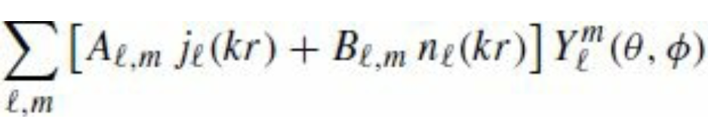
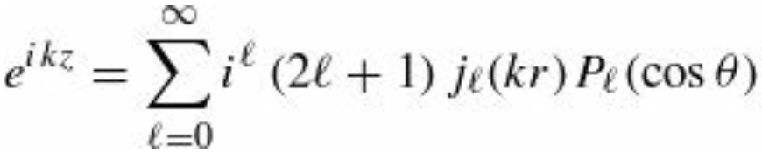
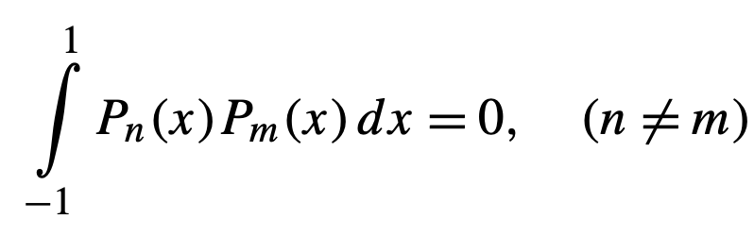
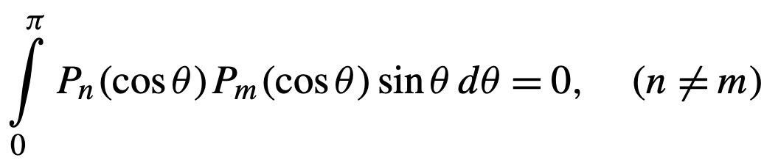
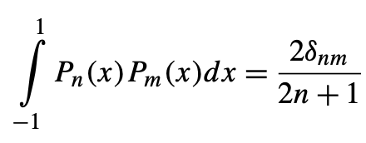
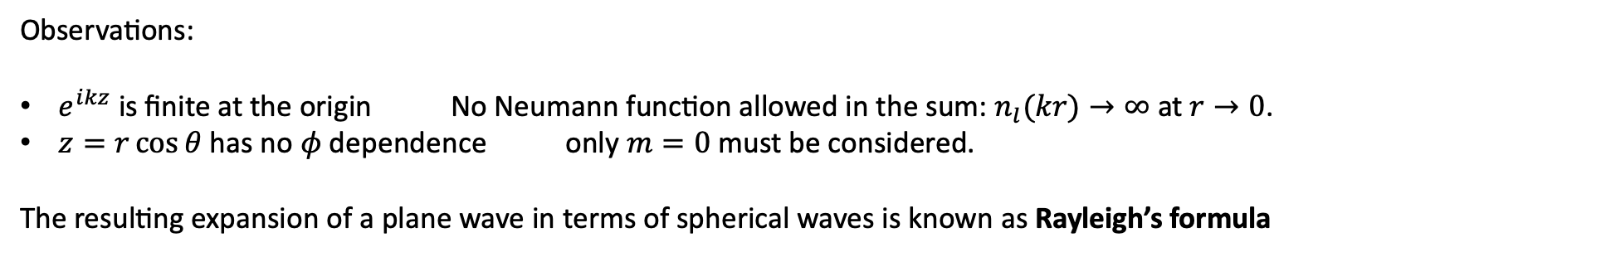
Recap: Partial wave analysis formalism
Observations:
$e^{ikz}$ is finite at the origin No Neumann function allowed in the sum:$n_{l}(kr)→∞$ at $r→0$.
$z=r\cos{θ}$ has no $φ$ dependence only $m=0$ must be considered.
The resulting expansion of a plane wave in terms of spherical waves is known as Rayleigh’s formula
To prove this relation, we need the orthogonality condition of the Legendre polynomials
In general, one has that

Slide 6
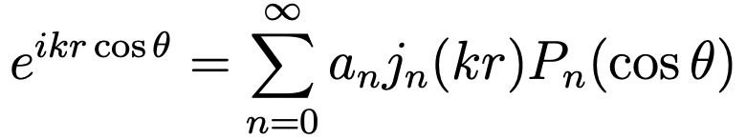
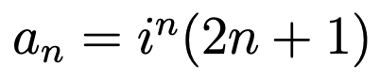
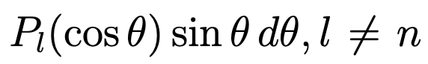
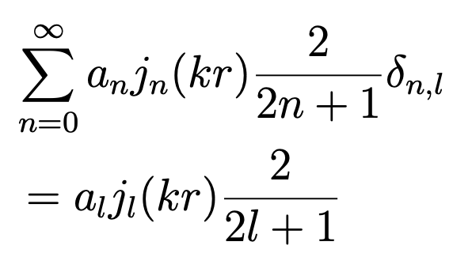
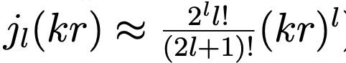
Proof of the Rayleigh’s formula
where $j_{n}(kr)$ is the spherical Bessel function of order $n.$
To prove this relation, we multiply LHS and RHS by and we integrate over $θ$
(1)
Using the orthonormality of Legendre polynomial, RHS of equation (1) reduces to
Since we are interested in the limit $kr → 0$, we Taylor expand the spherical Bessel function (see the extra notes in D2L)

Slide 7
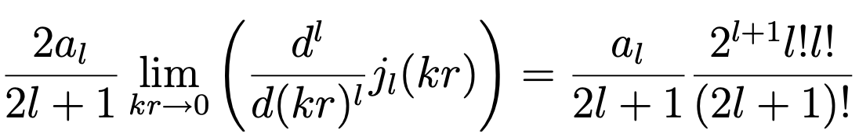
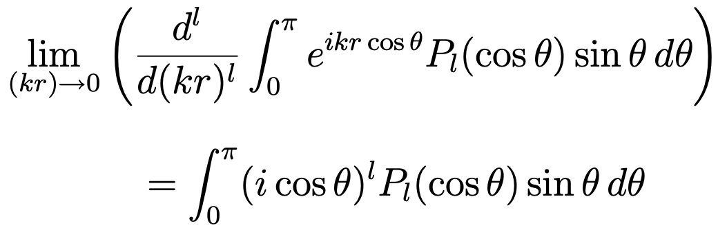
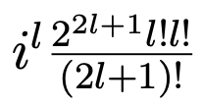
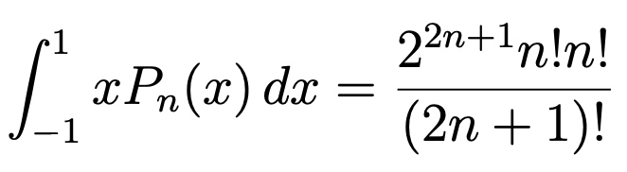
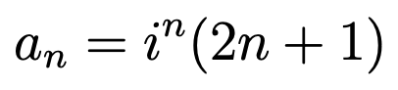
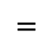
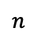
Proof of the Rayleigh’s formula
To eliminate the $r$ dependence, we differentiate Eq. (1) with respect to $(kr) l$ times and we take the limit $(kr)→0$. These steps for the spherical Bessel part on the RHS of Eq. (1) give
On the LHS of Eq. (1) we perform we implement the same procedure and obtain
$$=$$
where for the last integral we used the following result
$$n$$
This leads to our result

Slide 8
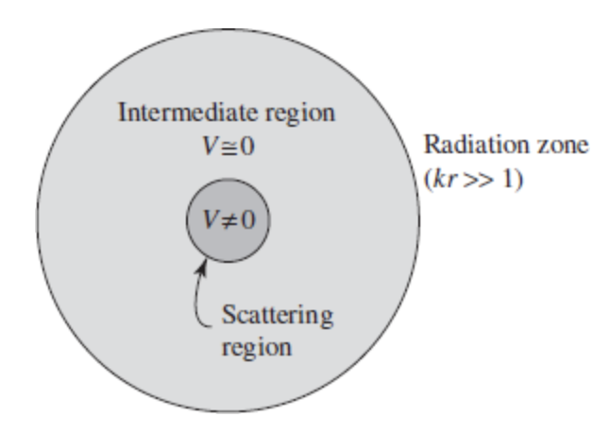
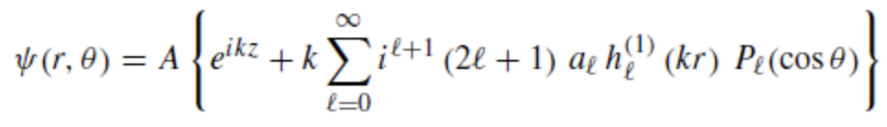
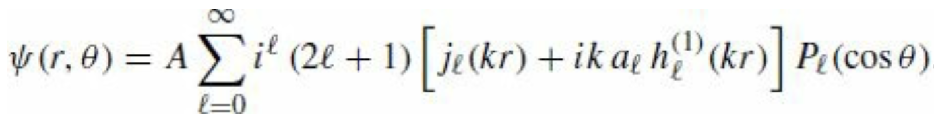
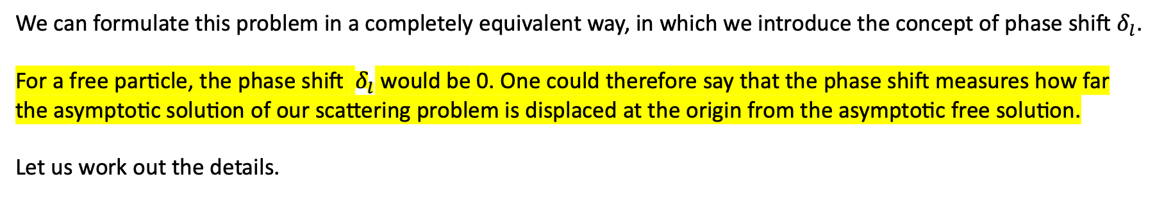
Partial wave analysis formalism
Using this, the wave function in the exterior region can be expressed entirely in terms of r and θ:
We can formulate this problem in a completely equivalent way, in which we introduce the concept of phase shift $δ_{l}$.
For a free particle, the phase shift $δ_{l}$ would be 0. One could therefore say that the phase shift measures how far
the asymptotic solution of our scattering problem is displaced at the origin from the asymptotic free solution.
Let us work out the details.

Slide 9
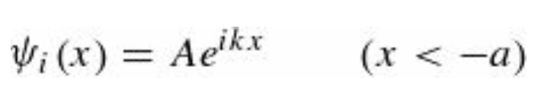
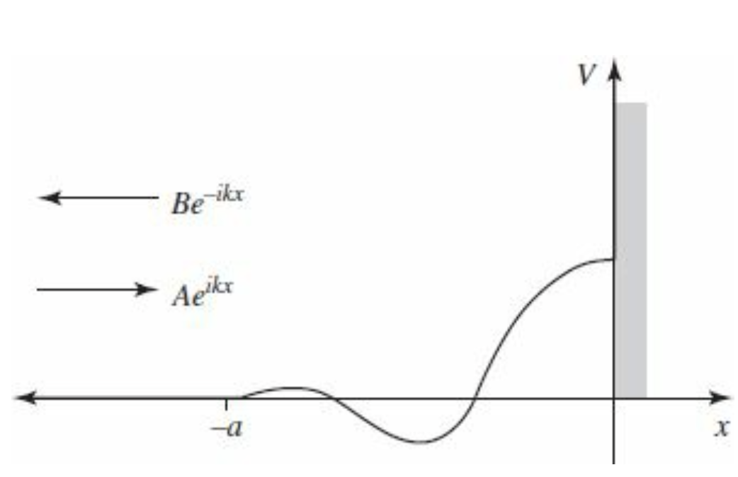
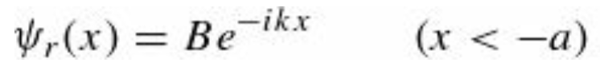
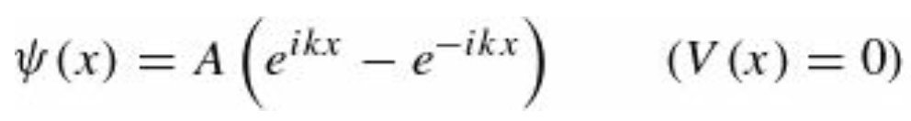
Phase Shifts
Consider first the problem of one-dimensional scattering from a localized potential $V(x)$ on the half-line $x<0$. Let’s put a “brick wall” at $x=0$ so a wave incident from the left,
is entirely reflected
Whatever happens in the interaction region $−a<x<0$,
the amplitude of the reflected wave has got to be the same as
that of the incident wave ($|A|=|B|$) by conservation of
probability. But it needs not have the same phase.
If there were no potential at all (just the wall at $x=0$), then
$B=−A$ since the total wave function (incident plus reflected)
must vanish at the origin:

Slide 10
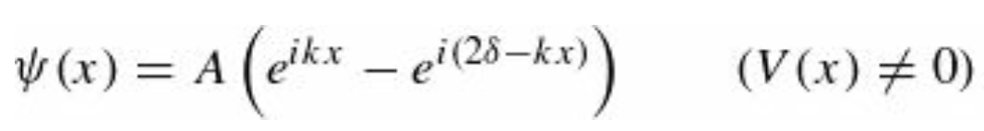
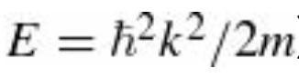
Phase Shifts
If the potential is not zero, the wave function (for $x<−a$) takes the form
The whole theory of scattering reduces to the problem of calculating the phase shift $δ$ as a function of k, and hence of the energy
for a specified potential. We do this, of course, by solving the Schrödinger equation in the scattering region $−a<x<0$
and imposing appropriate boundary conditions.
The advantage of working with the phase shift (as opposed to the complex number B) is that it exploits the physics
to simplify the mathematics (trading a complex quantity—two real numbers—for a single real quantity).

Slide 11
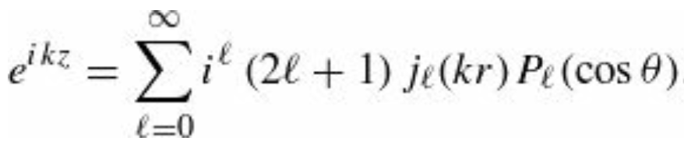
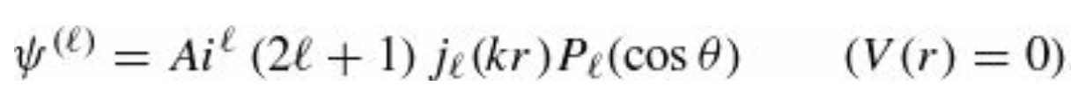
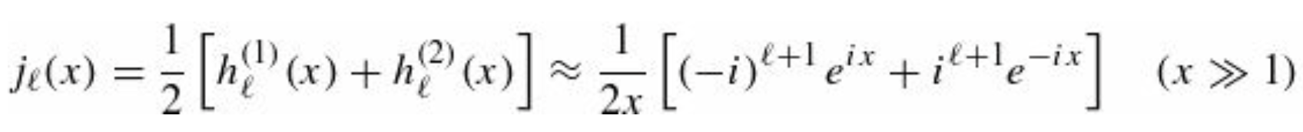
Phase Shifts
Now let’s return to the three-dimensional case. The incident plane wave ($Ae^{ikz}$) carries no angular momentum in the z direction (Rayleigh’s formula contains no terms with $m≠0$), but it includes all values of the total angular momentum
$l=0,1,2,…$ Because angular momentum is conserved (by a spherically symmetric potential), each partial wave (labelled by a particular $l$ ) scatters independently, with (again) no change in amplitude (we are now talking about “amplitude” in the original sense, e.g., the height of a sinusoidal wave) —only in phase.
If there is no potential at all, then $ψ=Ae^{ikz}$ and the $l$-th partial wave is
But from
we have that

Slide 12
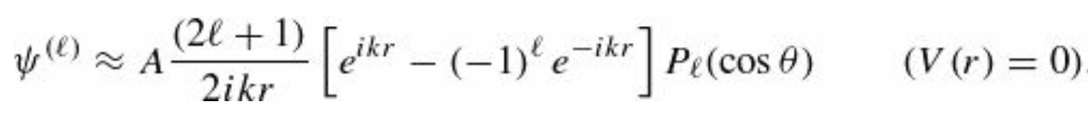
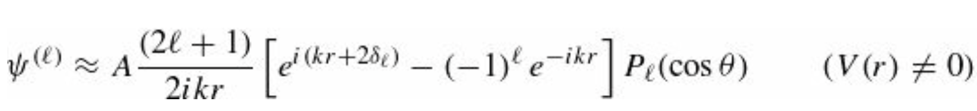
Phase Shifts
Therefore, at large $r$ (we are back to spherical coordinates here)
The second term inside the square brackets represents an incoming spherical wave; it comes from the incident plane wave and is unchanged when we now introduce a potential. The first term is the outgoing wave; it picks up a phase shift (due to the scattering potential):
We can think of it as a converging spherical wave (the $e^{−ikr}$ term, due exclusively to the $h_{l}^{(2)}$ component in $e^{−ikz}$) which is phase shifted an amount $δ_{l}$ on the way in, and again $δ_{l}$ on the way out (hence the factor of 2), emerging as an outgoing spherical wave (the $e^{ikr}$ term due to the $h_{l}^{(1)}$ part of $e^{ikz}$ plus the scattered wave).
We have previously expressed the whole theory in terms of the partial wave amplitudes $a_{l}$ now we have formulated it in terms of the phase shifts $δ_{l}$.
Therefore, there must be a connection between the two!

Slide 13
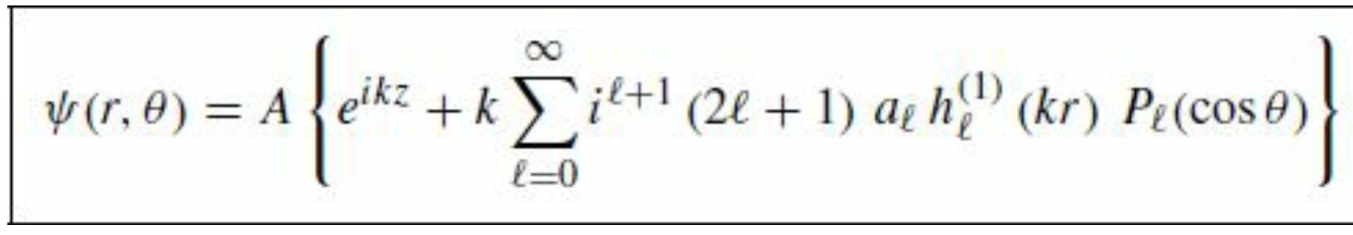
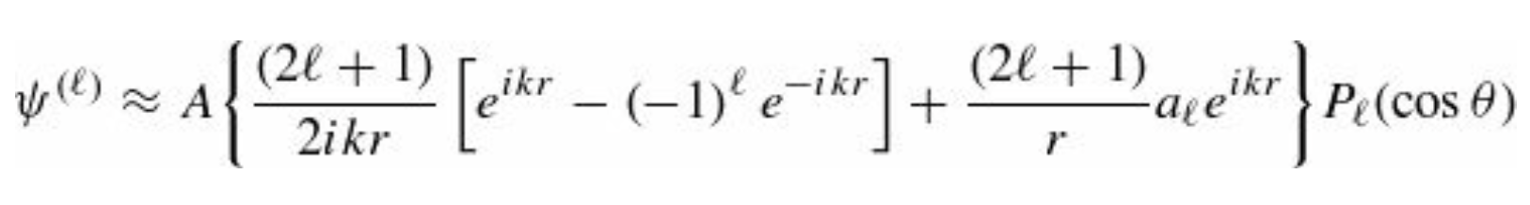
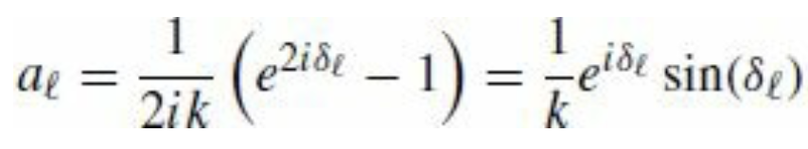
Phase Shifts
Indeed, comparing the asymptotic (large r) form of
with the generic expression in terms of $δ_{l}$ which we have seen before
we find that

Slide 14
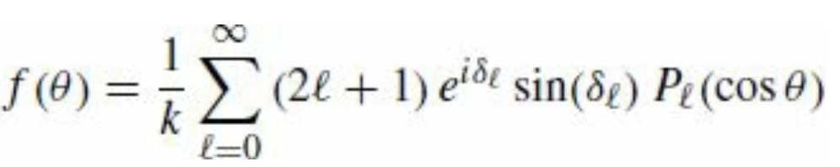
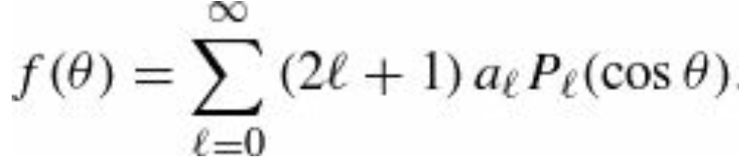
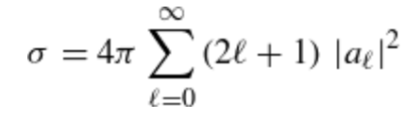
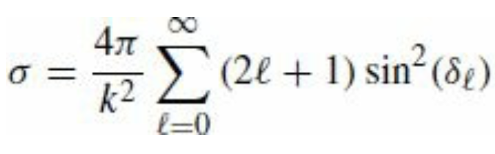
Phase Shifts
It follows in particular that
The differential cross section is obtained through
Again, the advantage of working with phase shifts (as opposed to partial wave amplitudes) is that they are easier to interpret physically, and simpler mathematically—the phase shift formalism exploits conservation of angular momentum to reduce a complex quantity $a_{l}$ (two real numbers) to a single real one $δ_{l}$.

Slide 15
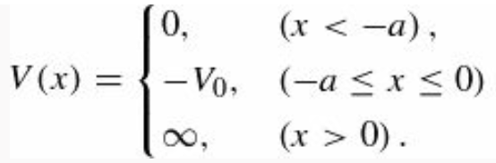

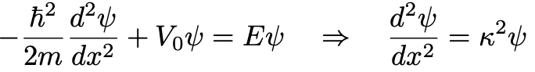






Example problem
A particle of mass m and energy E is incident from the left on the potential
A) If the incoming wave is $Ae^{ikx}$ where is $k=\sqrt{2mE}/ℏ$ find the reflected wave
B) Confirm that the reflected wave has the same amplitude as the incident wave.
C) Find the phase shift δ for a very deep well, that is, $E≪V_{0}$
A)
In the $−a<x<0$ region the TISE gives
LHS:
$$−a$$
0
x
with
$$−V_{0}$$
The general solution is:
Boundary conditions: $ψ(0) = 0$ implies $D = 0$, so
The continuity of $ψ(x)$and $ψ′(x)$ at $x = −a$ imposes that
LHS
RHS

Slide 16





Example problem
If we divide the two equations, then we can solve for B
B) Now that we know the coefficient B, we can determine
C) From part A), the wave function for $x < −a$ is
But, by definition of phase shift

Slide 17


Example problem
Therefore, equating the two terms we obtain
Exact result!
For a very high barrier
Therefore, we can approximate the exact relation as

Slide 18





The Born Approximation
So far, we have used the partial wave analysis to treat a generic scattering reaction with spherical symmetry.
However, at high energies, many partial waves contribute to the scattering amplitude, and it is preferable to avoid angular
momentum decomposition. A procedure that leads to a good approximation when the potential is weak, and the energy is
high is the Born approximation in which we consider the scattering process as a transition.
To introduce the Born approximation, we need to write the TISE in an integral form. We proceed as follows:
where

Slide 19


The Born Approximation
Relation to the Helmoltz equation. In mathematics, the Helmholtz equation is the eigenvalue problem for the Laplace
operator. It corresponds to the linear partial differential equation:
The inhomogeneous version of the Helmholtz equation is
If we look at the TISE which we wrote before
we note that it has the superficial appearance of the inhomogeneous Helmholtz equation. However, the “inhomogeneous”
term $Q$ itself depends on $ψ$. Suppose we could find a function $G(r)$ that solves the Helmholtz equation with
a delta function “source”:
here

Slide 20



The Born Approximation
Then we could express $ψ$ as an integral
It is easy to show that this satisfies the Schrödinger equation
$G(r)$ is called the Green’s function for the Helmholtz equation. (In general, the Green’s function for a linear differential equation represents the “response” to a delta-function source.)
Our first task is to solve the equation
for $G(r)$. This is most easily accomplished by using the Fourier transform of both sides, which turns the differential equation into an algebraic equation.

Slide 21





The Born Approximation
Let us consider the Fourier transform of G
Then
At this point we observe that
And generalizing the Dirac delta definition to the 3dim case, we obtain

Slide 22




The Born Approximation
Substituting this in the inhomogeneous Helmoltz equation
from which it follows that
Putting this expression back into that for $G(r)$
Now, r is fixed, as far as the s integration is concerned. At this point, we choose spherical coordinates.

Slide 23




The Born Approximation
But in this case the polar axis is aligned to r. The azimuthal integration is trivial and gives $2π,\text{the} \text{θ} \text{integral} \text{is}$
Thus,
The remaining integral is not so simple. It pays to revert to exponential notation, and factor the denominator:

Slide 24



The Born Approximation
These two integrals can be evaluated using Cauchy’s integral formula:
if $z_{0}$ lies within the contour (otherwise the integral is zero). In the present case the integration is along the real axis, and
it passes right over the pole singularities at $±k.$
We have to decide how to skirt the poles—we’ll go over the one at $−k$ and under the one at $+k$.
(We can in principle choose some other convention—even winding seven times around each pole—we’ll get a
different Green’s function, but, as we’ll show you in a minute, they’re all equally acceptable.)
For each integral in our equation, we must “close the contour” in such a way that the semicircle at infinity contributes nothing (Jordan’s Lemma in complex analysis).

Slide 25



The Born Approximation
In the case of $I_{1}$ the factor $e^{isr}$ goes to zero when s has a large positive imaginary part; for this one we close above
(see Fig. a). The contour encloses only the singularity at $s=+k$
In the case of $I_{2}$ the factor $e^{−isr}$ goes to zero when s has a large negative imaginary part; for this one we close below
(see Fig. b). This time the contour encloses only the singularity at $s=−k$ (and it goes around in the clockwise direction,
so we pick up a minus sign):

Slide 26





The Born Approximation
In conclusion we obtain
This, finally, is the Green’s function for the Helmholtz equation—the solution to the Helmoltz Eqn.
We can also check the result by direct differentiation.
If $G(r)$ is a Green’s function for the Helmoltz equation, we can add a generic $G_{0}(r)$ that satisfies the homogeneous
Helmholtz equation:
Clearly, $G\left(r\right)+G_{0}(r)$ is still a solution of
This ambiguity corresponds precisely to the ambiguity in how to skirt the poles—a different choice amounts to picking
a different function $G_{0}\left(r\right).$

Slide 27



The Born Approximation
The general solution to the Schrödinger equation takes the form
(*)
Where $ψ_{0}$ satisfies the free particle Schrödinger equation
Equation (*) is the integral form of the Schrödinger equation; it is entirely equivalent to the more familiar differential form.
At first glance it looks like an explicit solution to the Schrödinger equation (for any potential) —which is too good to be true.
Don’t be deceived: There’s a $ψ$ under the integral sign on the right-hand side, so you can’t do the integral unless you already
know the solution! Nevertheless, the integral form can be very powerful, and it is particularly well suited to scattering
problems, as we’ll see in a moment.

